Slide 1
Internetworking with TCP/IP
Dr. Nazrul Islam
Associate Professor
Department of Information and Communication Technology (ICT)
Mawlana Bhashani Science and Technology University
Tangail-1902, Bangladesh.

Slide 2
Outline
Definitions
Autonomous Systems
Basic Principles
Protocols
Protocol Layering and Encapsulation
OSI Model
TCP/IP Model
Network Organization
Network Technologies
Internet Standards
Useful Addresses

Slide 3
Definitions
To connect computers, one needs
Hardware, software and, above all, specifications
Internetworking
Hardware and software technology with the help of which multiple and diverse underlying hardware technologies are interconnected by providing a way to interconnect heterogeneous networks and a set of communication conventions (i.e., software) that make them interoperate
internet
Multiple networks connected together
It hides the details of network hardware and permits computers to communicate irrespective of their physical network connections
Internet
The worldwide internet
Global virtual network composed by many physical networks
Internet is NOT a physical network like, e.g., Ethernet

Slide 4
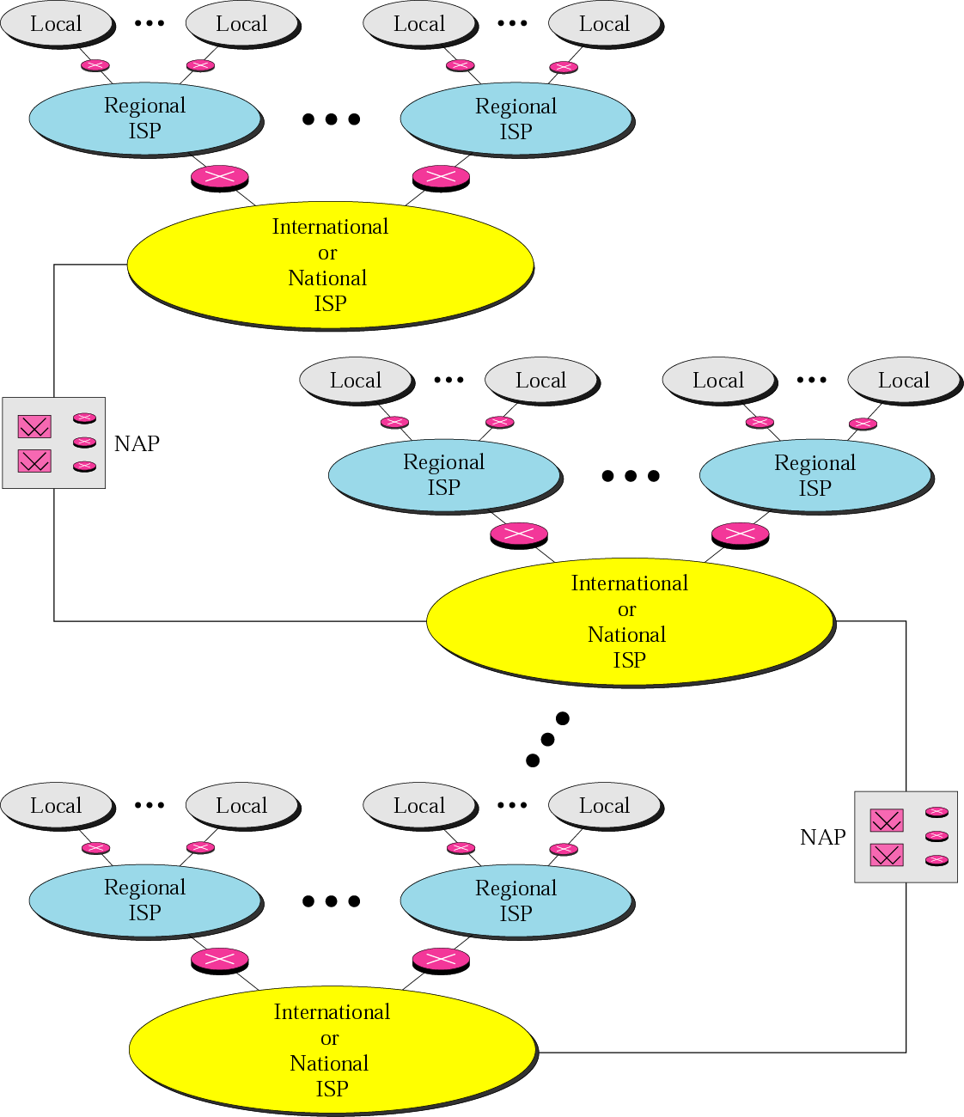
Definitions (cont)
Internet
Global virtual network composed by many physical networks
Intermediate System (IS), also known as Interworking Unit (IWU)
Machine that performs relaying and (perhaps) route discovery functions
Route discovery: process of finding the best route between two or more networks (or nodes) in the Internet
IS types
Bridges (Data Link Layer)
Routers (Network Layer)
Gateways (Transport Layer)
IS functions
Forwarding: using a routing table to make forwarding decisions
Routing: using route advertisements to acquire the knowledge to create the routing table that the forwarding protocol uses
Fig 1.1 – Forouzan 4th edition

Slide 5
Autonomous System
Autonomous System (AS)
Consists of a group of routers connecting several physical networks and exchanging information via Interior Routing Protocol (IRP)
The set of routers and networks are managed by a single organization
The protocol used to pass routing information among routers placed in different AS is referred to as Exterior Routing Protocol (ERP)
Three types of AS: Stub AS; Transit AS; Multi-homed AS
Administrative Domain (AD)
Virtual entity that corresponds to AS
Administrative entity determined by network administrator (e.g., ISP)
Functions: to partition the network; security administration; to provide accounting, billing and revenue services; etc.
Same class of addresses

Slide 6
Autonomous System (cont)
Subnetwork 2.1
Subnetwork 1.2
R6
R3
R2
Advertisements
Advertisements
IRP
IRP
Advertisements
Advertisements
Subnetwork 2.2
IRP
Subnetwork 1.3
IRP
Subnetwork 1.1
R5
Advertisements
R7
IRP
Advertisements
Advertisements
IRP
Advertisements
R4
Advertisements
ERP
R8
IRP
IRP
R1
Subnetwork 2.4
Subnetwork 1.4
Subnetwork 2.3
Autonomous System 1
Autonomous System 2

Slide 7
Basic Principles
End-to-end principle (David Clark and others)
Final decisions should always be made by the users
Trying to implement these decisions by intelligence inside the network is redundant
Control functions should thus by delegated as much as possible outside the network
In other words, the network does the routing and the end-system does the control
IP over everything (Vint Cerf)
Internet is build by layering a unique “Internetworking protocol” on top of various network technologies
Consequence: very simple to adopt new technologies in the Internet
Another advantage: worldwide addressing
Connectivity is its own reward
Connectedness is beneficial to all Internet users
Exponential grow
New applications

Slide 8
Protocols
Protocol
Set of rules and conventions used for communication of entities in different systems
Entity: anything capable of sending or receiving information
System: object that contains several entities
Key elements
Syntax (data format, coding), e.g., ASCII, EBCDIC, ANS1
Semantics (meaning, control information)
Timing (sequencing, synch/speed matching)
A protocol specification defines
Service interface: service offered to users
Peer interface: how it communicates with other nodes to implement the service interface
Communication architecture
Structured set of protocols that implement the information exchange
Most of communication architectures are layered

Slide 9
Protocol Layering
Protocol layering
Technique used to partition the tasks of networking into functional layers and assigning protocols to perform each layer’s task
Protocol layering produces simple protocols, each with well-defined tasks
The protocols can be assembled into a useful entity
Individual protocols can be removed or replaced as requested for specific applications
Protocol layering relies on encapsulation and multiplexing/demultiplexing
Most important layer protocol designs
OSI model (seven layers)
DoD (Department of Defense) model (four layers)
TCP/IP model (five layers): actual Internet model
Application layer: application specific protocols
Transport layer: process to process communication
Internet layer: host to host communication
Network Interface layer: transmitting IP packets over whatever network technology
Hardware: not an official layer

Slide 10
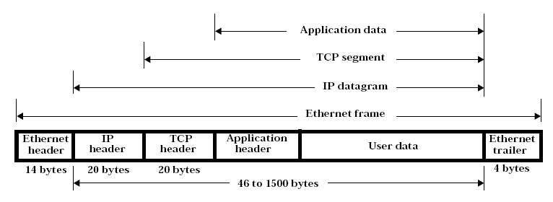
Protocol Encapsulation
Protocol encapsulation
Practice of enclosing data using a specific protocol with messages of another protocol
Multiplexing/demultiplexing
Different techniques of multiplexing and demultiplexing are used throughout the layered hierarchy
Examples: destination port number (application) in TCP/UDP header; protocol value (TCP/UDP/ICMP/IGMP) in IP header; frame type (IP/ARP/RARP) in Ethernet header

Slide 11
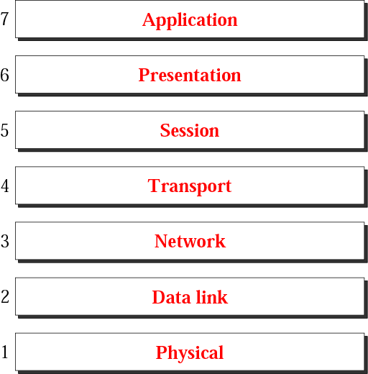
OSI Model
Fig 2.3 – Forouzan 3rd edition

Slide 12
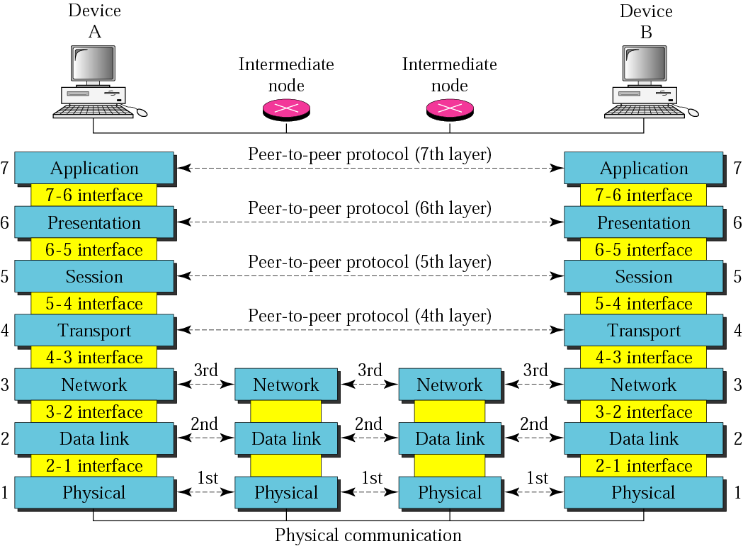
OSI Model (cont)
Fig 2.4 – Forouzan 4th edition

Slide 13
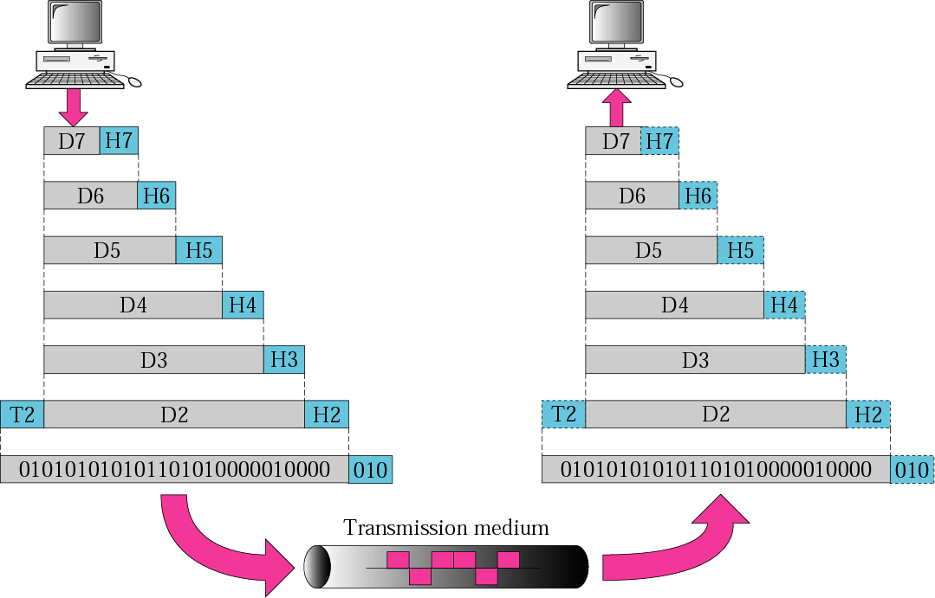
OSI Model (cont)
Fig 2.5 – Forouzan 4th edition

Slide 14
OSI Model (cont)
Application layer
Service: responsible for the communication management according to the specific service
Functions: everything is application specific
Examples: VT (Virtual Terminal); FTAM (File Transfer, Access and Management); MOTIS (Message Oriented Text Interchange Standard); ASE (Application Specific Service Elements); CASE (Common Application Service Elements); etc
Presence at TCP/IP: yes
Presentation layer
Service: provision of common operations on the data structures being exchanged (i.e., freedom from compatibility problems)
Functions: VT support; syntax conversion; cryptography; compression
Examples: ISO presentation protocols; ASN1 (Abstract Syntax Notation 1; universal, for both OSI and TCP/IP)
Presence at TCP/IP: no, it disappears; moved to the Operating System (OS)
Session Layer
Service: provision of proper control structure for the specific service, i.e., supports the dialog between cooperating application programs
Functions: session establishment, management and termination (moved to TCP at TCP/IP); synchronization (moved to application at TCP/IP); recovery (moved to OS at TCP/IP)
Examples: RPC (Remote Procedure Call); ISO session protocol
Presence at TCP/IP: no

Slide 15
OSI Model (cont)
Transport layer
Service: responsible for the provision of a reliable and transparent data transfer between end users
Functions: connection establishment, management and termination; error control; flow control; message delivery; multiplexing
Examples: ISO TP0-TP4
Presence at TCP/IP: yes
Network layer
Service: to make the upper layers independent of the topology, data transmission, routing and switching considerations
Functions: routing and switching functions needed to establish, maintain and terminate switched connections and transfer data between hosts, i.e., routing, addressing, switching and congestion control
Examples: X.25; CLNP (corresponds to IP)
Presence at TCP/IP: yes
Data link layer
Service: responsible for the reliable transfer of data across the links
Functions: synchronization/framing; error control; flow control
Examples: HDLC; LAP-B; LAP-D
Presence at TCP/IP: yes

Slide 16
OSI Model (cont)
Physical layer
Service: responsible for the transmission of bits across the physical medium ensuring reliable delivery of 0`s and 1`s
Functions: conversion of bits into electrical or optical signals; data transmission
Examples: X.21; RS-232
Presence at TCP/IP: yes

Slide 17
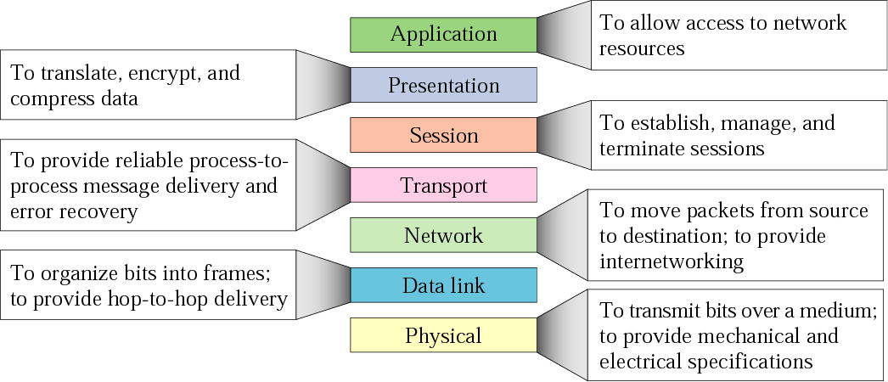
OSI Model (cont)
Summary of OSI layers
Fig 2.6 – Forouzan 4th edition

Slide 18
TCP/IP Model
Two models
DoD model: four-layers model developed in the 1970s for the DARPA Internetwork project that grew into the Internet
TCP/IP model: five-layers model that adhere to DoD, although OSI is sometimes preferred for new designs
DoD (Department of Defense) model
Process layer: protocols implementing user-level functions (corresponds to Application layer in TCP/IP)
Host-to-host layer: handles connection rendezvous, flow control, error control and other generic data flow management (corresponds to TCP in TCP/IP)
Internet layer: responsible for data delivering to destination (routing protocols, corresponds to IP in TCP/IP)
Network access layer: responsible for data delivering over a particular media (corresponds to DLL and PHY in TCP/IP)
TCP/IP model
Application layer: HTTP; FTP; Telnet; SMTP; DNS; BGP; DHCP; etc
Transport layer: TCP; UDP
Internet layer: IP
Network Interface layer: CSMA/CD; HDLC; LAP-B; LAP-D;
Media/Hardware layer: Ethernet (twisted pair; broadband coaxial; optical fiber); radio; infrared; etc

Slide 19
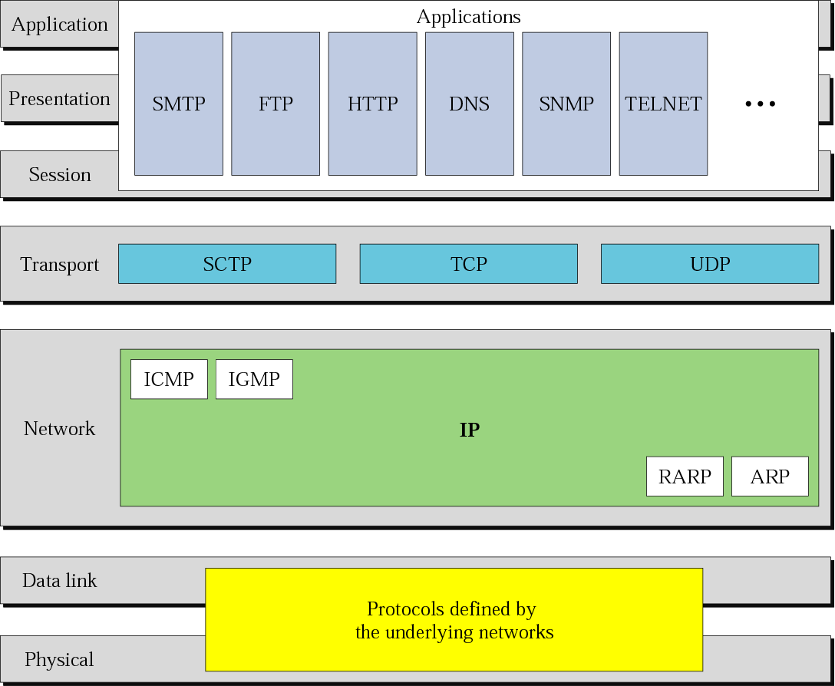
TCP/IP Model (cont)
TCP/IP and OSI model
Fig 2.15 – Forouzan 3rd edition

Slide 20
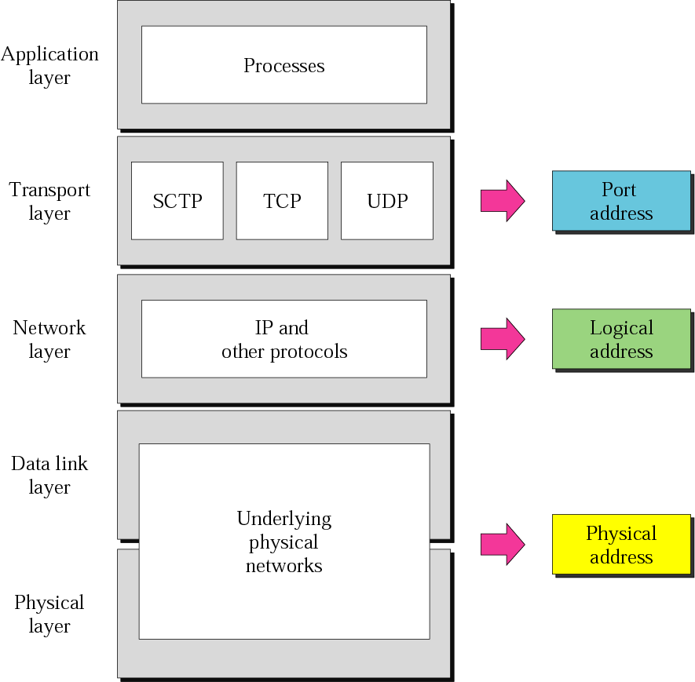
TCP/IP Model (cont)
Relationship of layers and addresses in TCP/IP
Fig 2.17 – Forouzan 3rd edition

Slide 21
Network Organization
Highest level: continental backbone network (continental ingress/egress routers)
Geographically distributed set of very high throughput routers interconnected by very high bit rate lines leased from one or more network providers
Same level: core backbone network (continental routers)
The continental backbones are interconnected by means of a core backbone network consisting of a small number of very high throughput (intercontinental) routers and leased lines
Second level: regional and/or national networks (national routers)
Geographically distributed set of high throughput routers interconnected by high bit rate leased lines; also, some legacy networks operating a different protocol stack from TCP/IP
Next level: access networks (national ingress/egress routers)
Networks attached to one of the regional/national networks/internetworks by means of either an IP access network gateway or the so-called multiprotocol gateway (to access networks with protocol stacks different from TCP/IP), e.g., LAN, diverse ISP networks, enterprise networks
Lowest level: hosts

Slide 22
Network Technologies
Important parameter related to network: Maximum Transmission Unit (MTU)
MTU depends upon the underlying network
Expressed in bytes
Examples of MTU:
1500 (Ethernet IEEE 802.3)
8191 (Token Bus IEEE 802.4)
4464 (Token Ring IEEE 802.5)
4352 (FDDI)
576 (X.25)
53 (ATM)
….
In order to avoid segmentation, one needs to know the so-called Path MTU, which is the smallest MTU of the e2e path
Besides MTU, there is also a minimum transmission unit, e.g., 64 bytes (Ethernet)
IP has also a maximum datagram length (header plus data) of 65,536 bytes
Types of communication networks
Telephone Networks (PSTN)
Local Area Networks (LAN): IEEE 802.3 (CSMA/CD)
Wireless Local Area Networks (WLAN): IEEE 802.11
Wide Area Networks (WAN): ADSL; CATV; SONET; FTTH; PPP; X.25; FR; ATM
Metropolitan Area Networks (MAN)
Radio Networks (RN): single-hop; multi-hop
Mobile Communication Networks (MCN): GSM; UMTS
Satellite Networks (SN)
Cable Television (CT)
…..
Ethernet implementations
10BASE5; 10BASE2; 10BASE-T; 10BASE-FL;
Fast Ethernet: 100BASE-TX; 100BASE-FX; 100BASE-T4;
Gigabit Ethernet: 1000BASE-SX/LX; 1000BASE-T;
Different standards for PHY and DLL

Slide 23
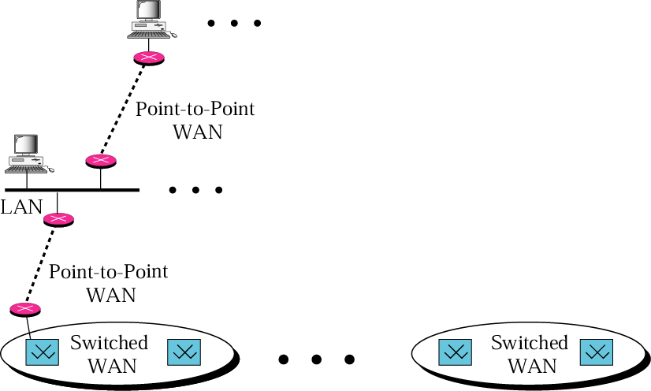
Network Technologies (cont)
Internet model
Fig 3.1 – Forouzan 3rd edition

Slide 24
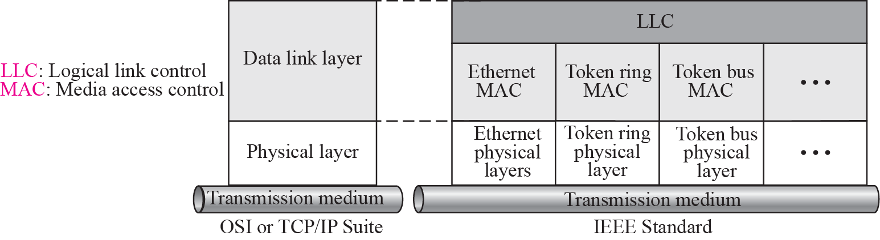
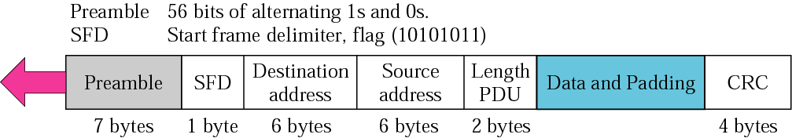
Network Technologies (cont)
Ethernet layers
Fig 3.1 – Forouzan 4th edition
Ethernet frame
Fig 3.2 – Forouzan 4th edition

Slide 25
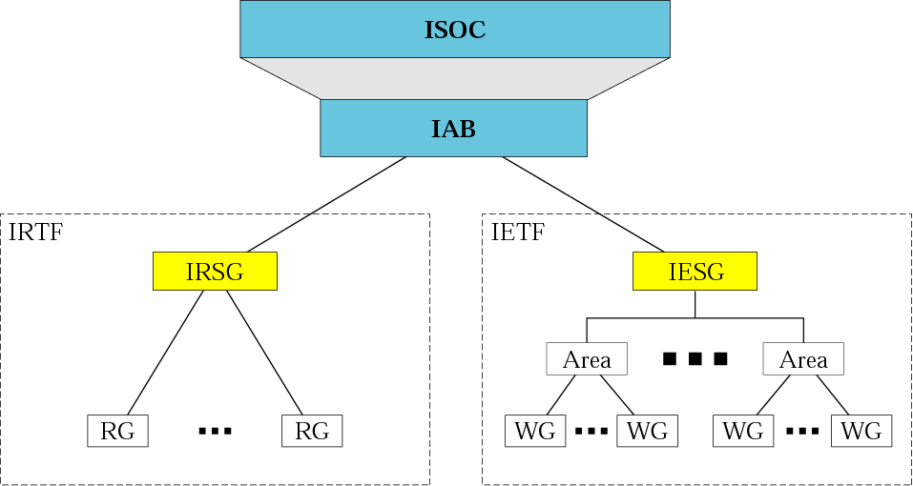
Internet Standards
Groups that coordinate diverse Internet issues
Internet Society (ISOC)
Internet Architecture Board (IAB)
Internet Engineering Task Force (IETF)
Internet Research Task Force (IRTF)
Internet Engineering Steering Group (IESG)
Internet Research Steering Group (IRSG)
Internet Assigned Numbers Authority (IANA)
Internet Cooperation for Assigned Names and Numbers (ICANN)
Network Information Center (NIC)
Internet administration
Fig 1.4 – Forouzan 4th edition

Slide 26
Useful Addresses
Internet history
http://www.isoc.org/internet/history/
Internet trends and surveys
http://www.isoc.org/internet/stats/
https://www.isc.org/
http://www.domainstats.com/
http://news.netcraft.com/
http://www.nua.ie/surveys/index.html
http://www.ripe.net/
IETF: Internet specifications
http://www.ietf.org

Slide 27
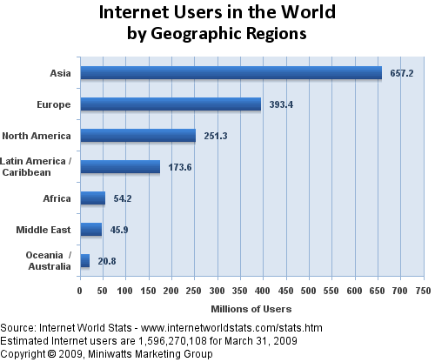
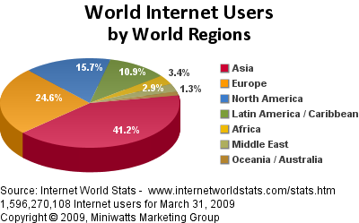
Internet Users
Source: http://www.internetworldstats.com/stats.htm August 2009

Slide 28
References
Forouzan B.F,”TCP/IP Protocol Suite”, 4th edition, McGraw-Hill, chapters 1, 2, 3
Other useful addresses

Slide 29

THANK YOU!

